Slide 1

The Department of Electronics And Communication
Course Level Problem Based Learning
Course Title: DDHDL Verilog
Course Code:22ECE42
Semester: Fourth Semester
Project Titled : FPGA implementation of ECG signals using FIR filter
Sl No. | USN | Name
1 | 4S024EC018 | ASTEL JOSWIN RODRIGUES
2 | 4SO24EC006 | AJAY KUMAR P
3 | 4S024EC021 | BASHMA
4 | 4SO24EC022 | BRAHMI LAKSHMI U.H

Slide 2
Work Distribution
BASHMA
Chapter 1:
Introduction→ Background, Problem. Statement, Objectives.
AJAY KUMAR P
Chapter 2:
Literature Review (Secondary Research)→Review of Existing Work, Comparative Analysis Table, Research Gap Identification.
BRAHMI LAKSHMI U.H
Chapter 3:
Proposed System Design→ Design Justification, Block Diagram, Architecture Diagram
ASTEL JOSWIN RODRIGUES AND AJAY KUMAR P
Chapter 4:
Leaf Cell Design→Identification of Leaf Cells, Leaf Cell Description, Leaf Cell Simulation

Slide 3
Main objective of the proposed project:
The primary objective of this work is to design and implement an FPGA-based ECG signal processing accelerator that filters raw ECG signals from dataset(predefined signals). The system applies a FIR filter with transfer function 0.5 + 0.5z⁻¹ to suppress high-frequency noise while preserving essential cardiac waveform features. The work aims to utilize FPGA’s sequential processing capability to achieve low-latency performance compared to software-based implementations. Finally, the system seeks to produce a clean filtered ECG output, demonstrating that a FIR filter structure on reconfigurable FPGA hardware can serve as an efficient and flexible foundation for biomedical signal processing applications.

Slide 4
Literature survey results:
As per four distinct FPGA-based approaches to ECG denoising, it collectively demonstrates that hardware parallelism superiorly handles noise reduction compared to software.
Rayka and Bansod (2015) utilized a resource-efficient median filter.
Uttraphan et al. (2024) implemented an optimized 21-tap FIR filter using a Kaiser window, showing up to 1,250 times faster processing than MATLAB.
Mulla and Kishtwar (2014) introduced a high-throughput, low-resource LMS adaptive filter using a Radix-2 Montgomery multiplier, achieving 22 dB SNR improvement.
Key research gaps identified include limited reporting of comprehensive resource utilization (LUTs, Fmax) across all studies
What is understood:
Based on the research, a 16-tap FIR filter is selected for the proposed system to balance effective noise removal with minimal hardware complexity, as fewer taps inadequately remove noise, while excessive taps increase resource usage and processing delay.

Slide 5
Comments: 1)Do you have real time signal or from datasets? Ans) Datasets

Slide 6
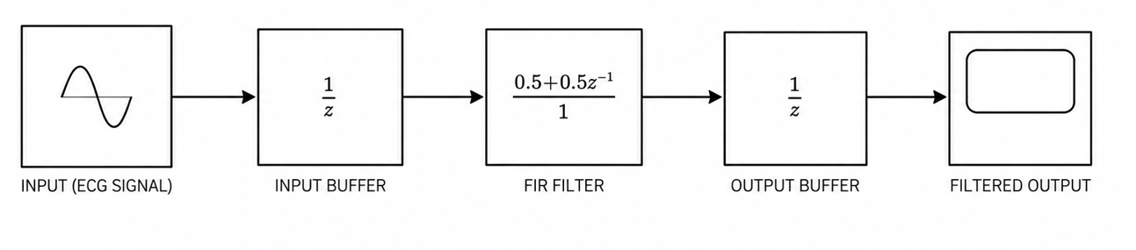
BLOCK DIAGRAM
INPUT: The ECG input provides the raw biomedical signal which may contain useful cardiac information along with noise and interference.
INPUT BUFFER :The input buffer temporarily stores incoming sampled ECG signals before they are processed by the FIR filter. 1/z represents a one-sample delay element.
FIR FILTER (MAIN BLOCK): This is the main block concentrated in the system. FIR stands for Finite Impulse Response filter. The filter performs the main signal processing operation. The filter reduces unwanted noise present in the ECG signal. This block plays an important role in obtaining a clear ECG output. The term 0.5+0.5z⁻¹/1 indicates that the FIR filter combines equal portions of the current and previous input samples to produce a smoother output signal.
OUTPUT BUFFER: This block introduces another one-sample delay. It stabilizes the processed signal before output.
OUTPUT: This is the final filtered ECG signal obtained from the system. Noise and unwanted disturbances are reduced significantly.

Slide 7
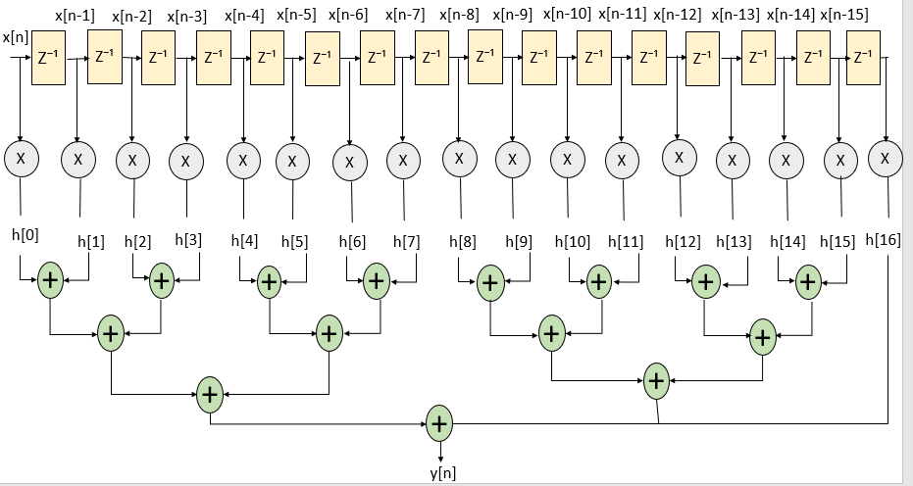
ARCHITECTURE

Slide 8
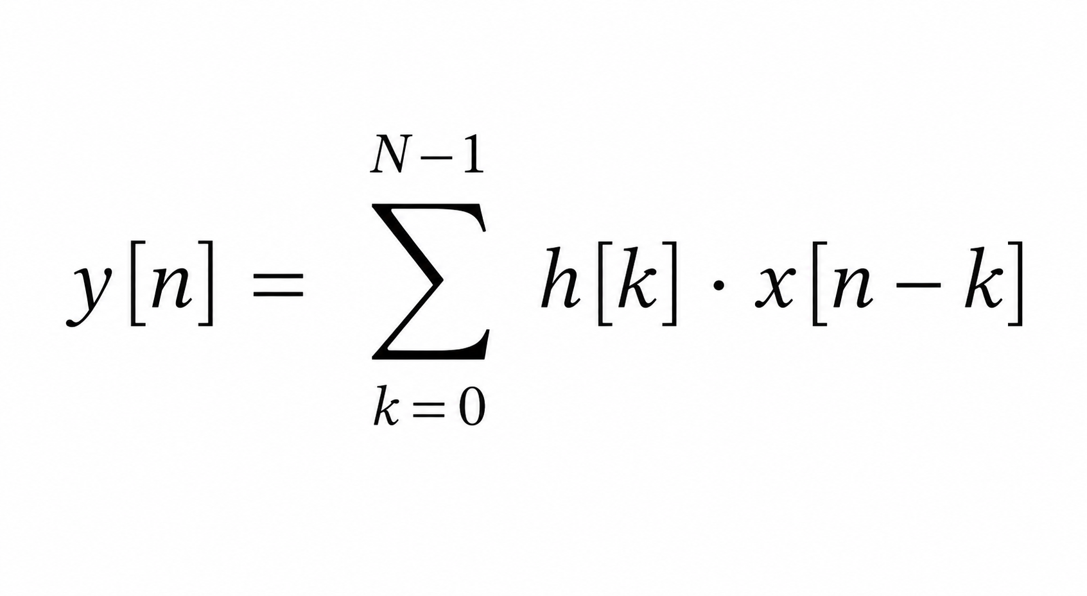
FORMULA:
y[n] = h[0]x[n] + h[1]x[n−1] + h[2]x[n−2] + h[3]x[n−3] + h[4]x[n−4] + h[5]x[n−5] + h[6]x[n−6] + h[7]x[n−7] + h[8]x[n−8] +h[9]x[n−9] + h[10]x[n−10] + h[11]x[n−11] + h[12]x[n−12] + h[13]x[n−13] + h[14]x[n−14] + h[15]x[n−15]
DELAY ELEMENT :
Stores the input signal for one sample time.
Produces delayed versions such as x[n-1],x[n-2],etc
Helps the filter use previous signal values for processing.
MULTIPLIER BLOCK:
Multiplies each delayed signal with a filter coefficient h[k].
ADDER BLOCK :
Adds all multiplied outputs together.
Produces the final filtered output signal y[n].
FILTER COEFFICIENTS:
These are constant values used for filtering.
OUTPUT SIGNAL:
Represents the final filtered signal.

Slide 9
Comments:
1)Applying predefined coefficients to the input signal, is it integer or fraction?
Ans)while the storage format is integer, the functional representation during the convolution process is fractional to maintain precision.

Slide 10
Leaf cell Design:
Delay
In digital design, delay is the time interval between an input signal changing and the corresponding output signal responding. It represents the finite time required for transistors to switch and for signals to travel through logic gates or wires.
Each delay element is implemented using 16-bit D flip-flops, and all the delay elements together form the shift register of the fir filter.
Multiplier
A digital multiplier is a combinational logic circuit used in digital systems (like ALUs, CPUs, and DSPs) to compute the product of two binary numbers (multiplicand and multiplier). It works by generating partial products, typically using AND gates, which are then summed together using binary adders to produce the final product.
Adder:
A 16-bit ripple carry adder is a digital combinational circuit that adds two 16-bit binary numbers (\(A_{15-0}\) and \(B_{15-0}\)) plus a carry-in (\(C_{in}\)), producing a 16-bit sum (\(S_{15-0}\)) and a final carry-out (\(C_{out}\)). It works by cascading 16 full adders, where the carry-out of each stage connects to the carry-in of the next stage. 16-bit ripple carry adders are used in digital signal processing and microprocessors for tasks requiring addition where minimal circuit area is preferred over high-speed performance.

Slide 11
Time line:
Start date :March 20 2026
End date: May 2 2026
Research papers from IEEE and springer:
Assigned date : April 18 2026
Ajay Kumar p :
Research papers based on FIR filters using verilog code
Deadline : 12th April 2026
Work completed
Bramhi :
Block diagram and architecture
Deadline: 14 April 2026
Work completed
Bhasma:
Introduction , problem statement, objective
Deadline:12 April 2026
Work incomplete
Astel:
Leaf cells and design
Deadline :16th April
Work completed

Slide 12
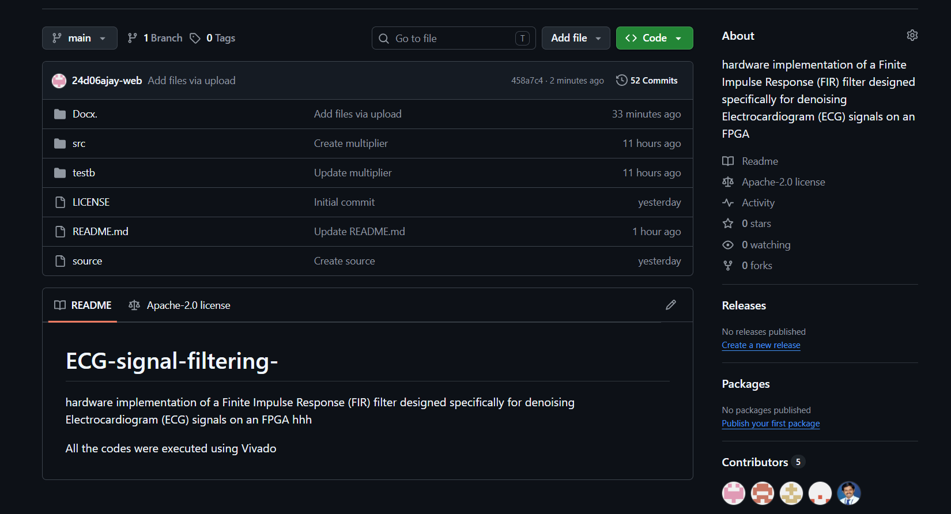
GitHub Repository Details
https://github.com/24d06ajay-web/ECG-signal-filtering-.git

